Slide 1
External Materials in AC/DC
Quick Start Guide

Slide 2
Overview
A new way to specify user-defined material models included in COMSOL Multiphysics version 5.2.
You can now access external material functions, written in C code, which have been compiled into a shared library.
By writing a gateway function in C code, you can also use material functions written in another programming language.
This makes it possible to program your own material models and distribute such models as add-ons.
Available with the
AC/DC Module (2D magnetics available without the AC/DC Module)
Structural Mechanics Module
MEMS modules
Examples include a model file, a source code file, and a shared library compiled and linked for 64-bit Windows
Running the models on Linux™ and OS X requires additional compilation and linking

Slide 3
External Materials
The external material model is implemented as a C-function with a certain calling convention, compiled and linked to create dynamically linked libraries that can be called from a material node in the Model Builder at runtime.
For details, see the section Working with External Materials in the COMSOL Multiphysics Reference Manual.

Slide 4
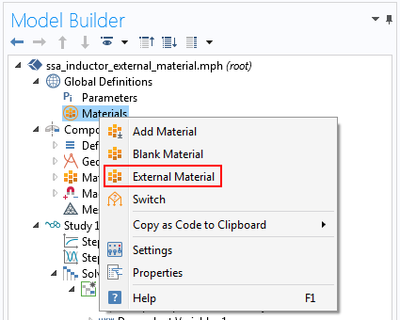
Add External Material
Under Global Definitions, right click Materials and add External Material
In the Settings window, browse to the path of the library file compiled for your OS (e.g. .dll for Windows)

Slide 5
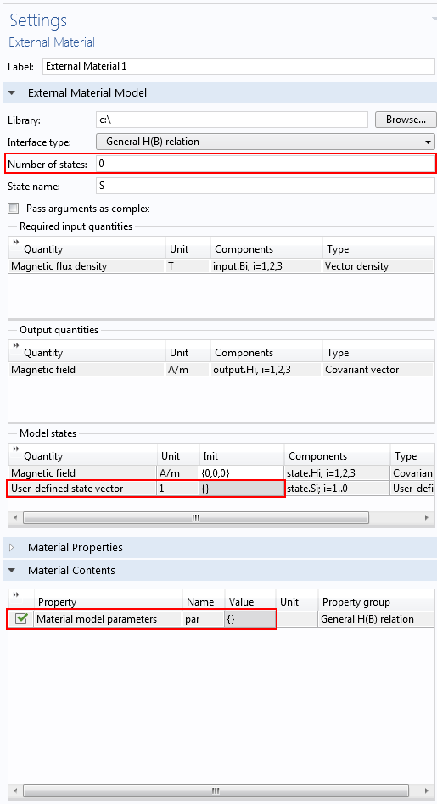
Set Up The Material
Choose the appropriate Interface type:
General H(B) Relation for Magnetic Fields, Magnetic and Electric Fields, and Rotating Machinery, Magnetic.
General B(H) Relation for Magnetic Fields, No Currents and Magnetic Field Formulation.
Specify the Number of states that the external library requires (for the example library, zero)
In the Model states table, enter the initialization vector for the states (for the example library, an empty vector: {})
In the table in Material Contents section, specify the Material models parameters required by the external library (for the example library, no parameters are needed, so specify the empty vector: {})

Slide 6
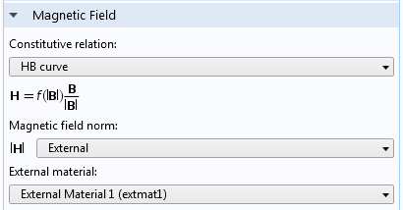
Use The Material
Go to the domain feature of the physics (Ampère’s Law, Magnetic Flux Conservation...)
In the Magnetic Field section, select HB curve as the Constitutive relation
Select External as the Magnetic field norm specification
Select the External material previously added

Slide 7
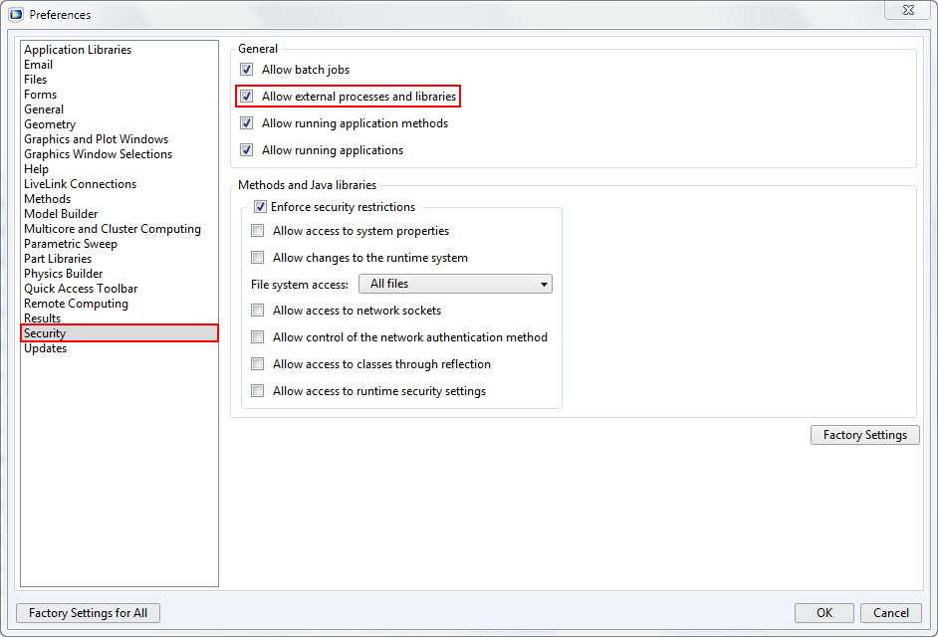
Security Settings
Use of external libraries is disabled by default for security reasons
In the Preferences window, under Security, check the Allow external processes and libraries check box
If external libraries are not allowed, an error occurs while solving

